Slide 1
“Prediction of building energy consumption”
Energy AI Track Kim Sohee
Amasyali, Kadir, and Nora M. El-Gohary. "A review of data-driven building energy consumption prediction studies."
Renewable and Sustainable Energy Reviews 81 (2018): 1192-1205.
Notes:
A review on the prediction of building energy consumption
https://doi.org/10.1016/j.rser.2012.02.049
Zhao, Hai-xiang, and Frédéric Magoulès. "A review on the prediction of building energy consumption."
Renewable and Sustainable Energy Reviews 16.6 (2012): 3586-3592.
A review of data-driven building energy consumption prediction studies
https://doi.org/10.1016/j.rser.2017.04.095

Slide 2
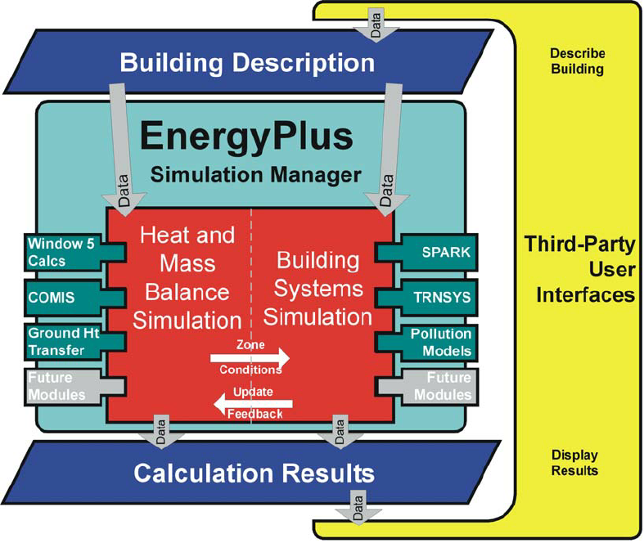
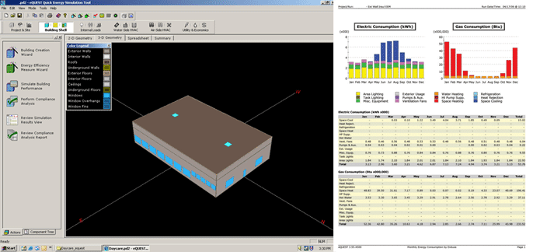
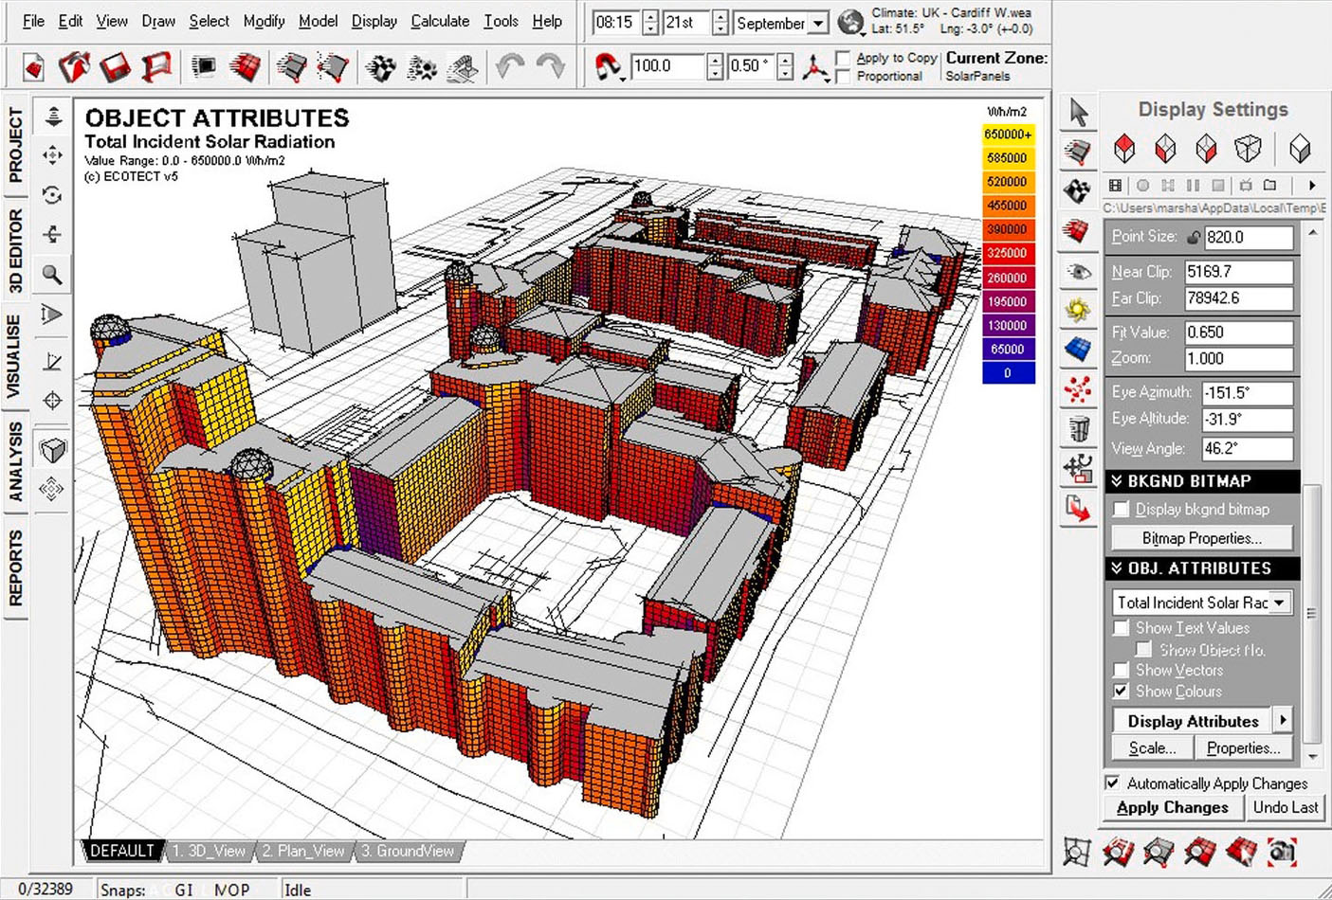
Prediction models
Engineering models (Physical models)
Rely on thermodynamic rules for detailed energy modelling and analysis
Software : EnergyPlus, eQuest, and Ecotect
Calculate building energy consumption based on detailed building and environmental parameters
Detailed data may not be available to the users at the time of simulation
Failure to provide accurate input can result in poor prediction performance
> EnergyPlus
(whole building energy simulation program)
> eQuest
(Building energy analysis program)
> EcoTect
-1-
Notes:
There are several popular methods used for forecasting building energy consumption, that can be categorized into two main approaches, engineering and data-driven approach.
First, Engineering models rely on thermodynamic rules for detailed energy modelling and analysis.
Examples of building energy simulation software that utilize physical models include EnergyPlus, eQuest, and Ecotect.
These types of software calculate building energy consumption based on detailed building and environmental parameters such as building construction details; operation schedules; HVAC design information; and climate, sky, and solar/shading information.
The pictures shows each software program.
EneryPlus is a whole building energy simulation program, and eQuest is a building energy analysis program.
Ecotect is a program that supports architect's design through analysis of various factors of building performance for energy efficiency and sustainable design.
However, some of such detailed data may not be available to the users at the time of simulation.
Failure to provide accurate input can result in poor prediction performance.

Slide 3
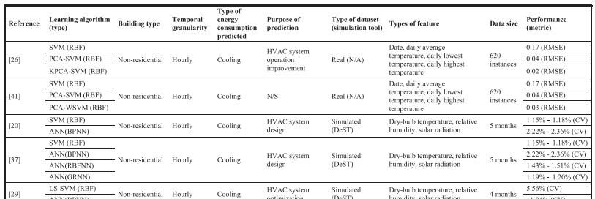
Prediction models
Data-driven models
Learns from historical/available data for prediction
Correlate the energy consumption or energy index with the influencing variables
4 steps : data collection, data preprocessing, model training, and model testing
Machine learning algorithms : SVM, ANN, decision trees, and other statistical algorithms
-2-
Notes:
Data-driven modelling does not perform such energy analysis or require such detailed data about the simulated building, and instead learns from historical/available data for prediction. They correlate the energy consumption or energy index with the influencing variables.
Data-driven prediction has gained a lot of research attention in recent years, despite its possible limitations.
Developing a data-driven model, typically, consists of four primary steps: data collection, data preprocessing, model training, and model testing.
SVM, ANN, decision trees, and other statistical algorithms are the most commonly-used supervised machine learning algorithms for model training.
This table summarizes the features used in the reviewed models.

Slide 4
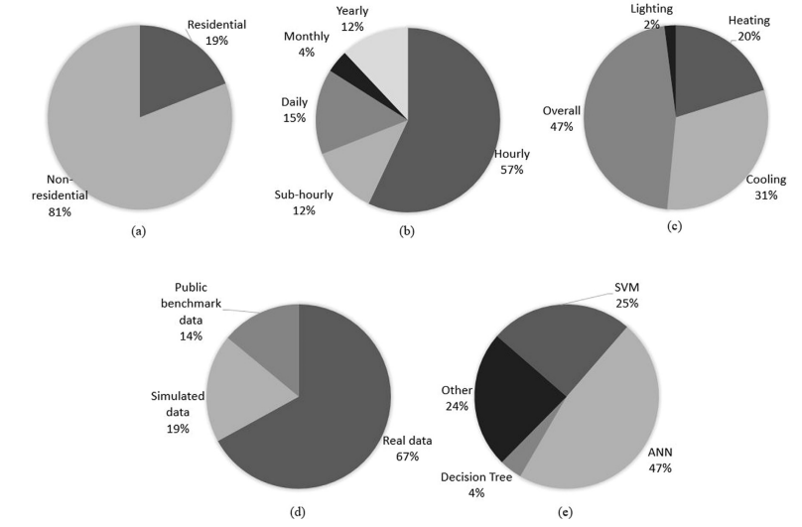
Distribution of the Data-driven models
(a) Type of building
(b) Temporal granularity
(c) Type of energy
consumption
(d) Type of data
(e) Machine learning algorithm
-3-
Notes:
This shows the distribution of the reviewed models according to 5 things.
Only 19% of these models focused on residential buildings, with the remaining models focusing on non-residential buildings including commercial and educational buildings.
The majority of these models, 57%, were developed for predicting hourly energy consumption, while 12%, 15%, 4%, and 12% of the models focused on sub-hourly, daily, monthly, and yearly consumption, respectively.
Overall, 47% of the models focused on predicting overall energy consumption, with 31% and 20% focusing on cooling and heating energy consumption, and only 2% focusing on lighting energy consumption prediction.
The data were classified into 3 types, real data, simulated data, and public benchmark data(datasets provide for energy consumption prediction competitions). The (67%) of these studies used real data to train and test their models, while 19% and 14% of the studies used simulated and public benchmark data,
At machine learning algorithm, 47% and 25% of the studies utilized ANN and SVM, to train their models. Only 4% of the studies utilized decision trees. The other, 24% of the studies utilized other statistical algorithms such as MLR, OLS, and ARIMA.
In the paper, The properties of the data used for training and testing these models were reviewed, including the types of data , the types of features (i.e., features related to outdoor weather conditions, indoor environmental conditions, building characteristics, time, occupant energy use behavior and occupancy, and historical energy consumption data), and the sizes of the data.

Slide 5
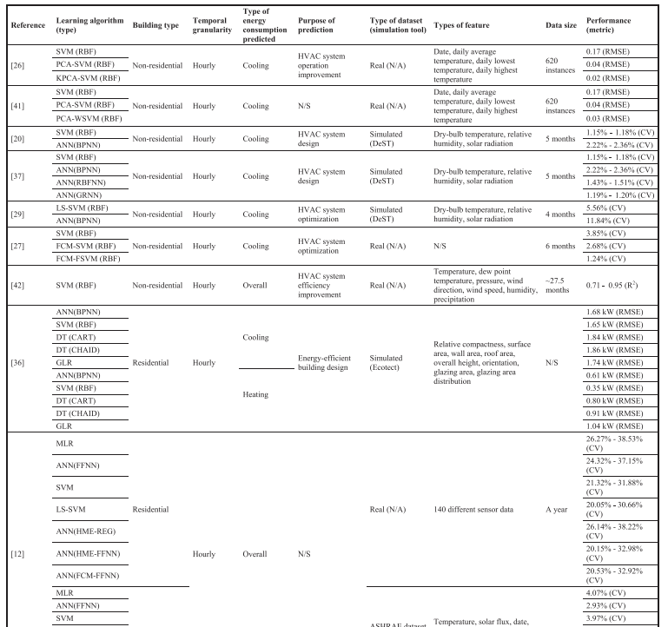
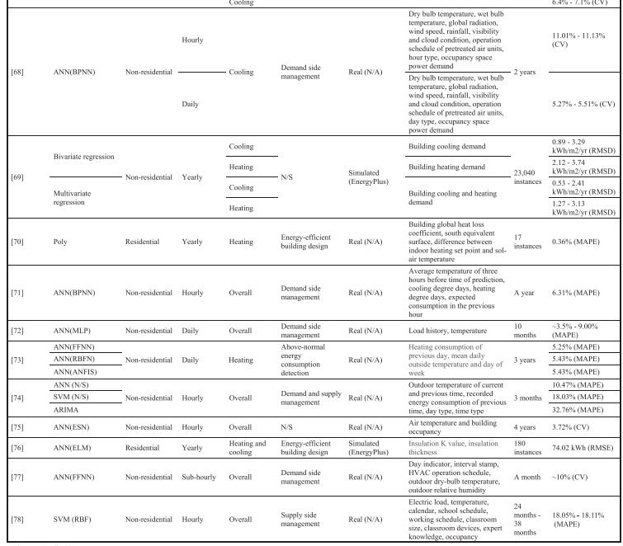
Energy consumption prediction models
-4-
Notes:
The paper presented an overview of recent research efforts in the area of data-driven building energy consumption prediction.
The scope of a set of models was reviewed in terms of building types, and so on.
So, I want to review some of these models in detail that is in this table.

Slide 6
Prediction models
Data-driven models Limitations
Data-driven prediction models may not perform well outside of their training range.
Black-box models – their internals are not known
Hybrid or grey-box modelling approaches (physical + data-driven)
[66] Li K, Su H, Chu J. Forecasting building energy consumption using neural networks and hybrid neuro-fuzzy system: a comparative study. Energy Build2011;43:2893–9. http://dx.doi.org/10.1016/j.enbuild.2011.07
[70] Catalina T, Iordache V, Caracaleanu B. Multiple regression model for fast prediction of the heating energy demand. Energy Build 2013;57:302–12. http://dx.doi.org/10.1016/j.enbuild.2012.11.
[77] Chae YT, Horesh R, Hwang Y, Lee YM. Artificial neural network model for forecasting sub-hourly electricity usage in Commercial buildings. Energy Build2016;111:184–94. http://dx.doi.org/10.1016/j.enbuild.2015.11.04
[98] Dong B, Li Z, Rahman SMM, Vega R. A hybrid model approach for forecasting future residential electricity consumption. Energy Build 2016;117:341–51. http:// dx.doi.org/10.1016/j.enbuild.2015.09.033.
Kim, Tae-Young, and Sung-Bae Cho. "Predicting residential energy consumption using CNN-LSTM neural networks." Energy 182 (2019): 72-81. https://doi.org/10.1016/j.energy.2019.05.230
-5-
Notes:
Despite the importance of data-driven approaches, It has two main limitations.
First, Data-driven prediction models may not perform well outside of their training range.
And they are black-box models, their internals are not known.
On the other hand, Hybrid or grey-box modelling approaches offer a combination of physical and data-driven prediction models, thereby leveraging the advantages and minimizing the disadvantages of both approaches.
There are several papers which developed a hybrid model.
So, I may review some of the hybrid models, too.
Dong B, Li Z, Rahman SMM, Vega R. A hybrid model approach for forecasting future residential electricity consumption. Energy Build 2016;117:341–51. http:// dx.doi.org/10.1016/j.enbuild.2015.09.033

